Slide 1
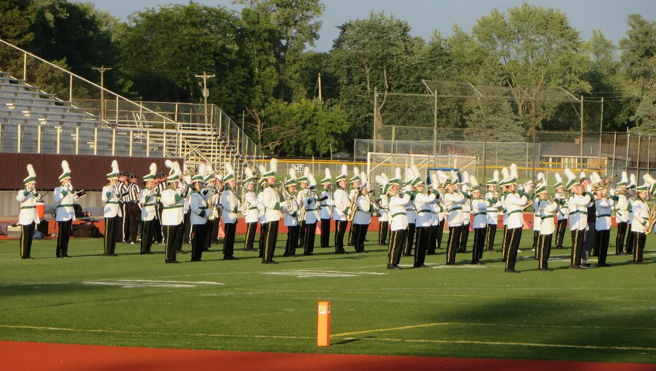
Parent Night 2024
Uniforms

Slide 2
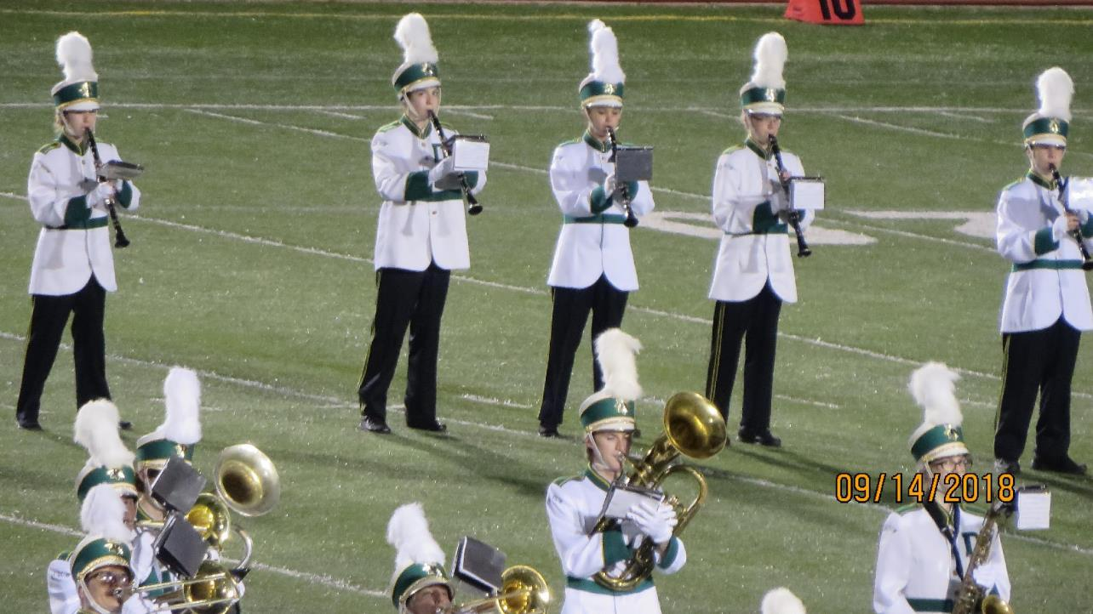
Hats & Plumes
Hats
Name sticker inside hat
2 finger widths from bridge of nose
Hair in a bun Inside hat
Plumes
Distributed and collected at games
If it comes home:
  Handle with gloves on
  Store inside zip lock bag
  Lay flat

Slide 3
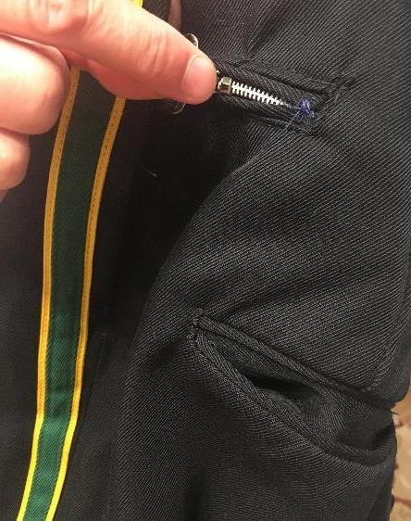
Suspenders and Sizers
Sizers are adjusted so waist is not snug – we’ll need the extra room when it gets cold and we layer.
Suspenders are required – practice putting them on. We recommend keeping suspenders attached to pants.

Slide 4
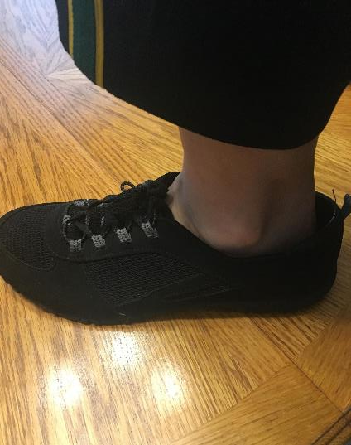
Socks and Shoes
Long, black socks
Black shoes
Soles not black? Use permanent marker or spray paint to color them in!

Slide 5
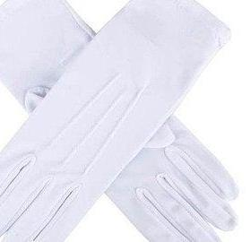
Gloves
Your student has a pair provided by the Music Boosters, if they get lost, they may purchase a new pair or they will receive a used pair to replace them.
Wash them often – they get gross, ok to use bleach
If you lose them talk to Mrs. Gavin 989-205-1838 or Mrs. Mead 989-859-4065

Slide 6
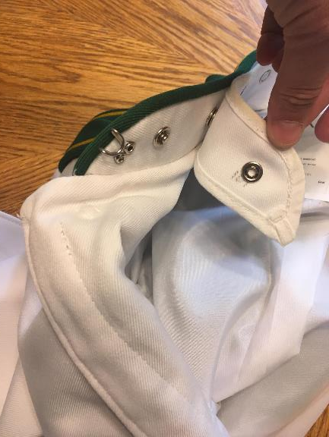
Air dry damp uniforms after performances
Pro Tip #1:
Wash the collar liner and gloves frequently
Pro Tip #2:
Wear the band shirt under your uniform jacket.
Pro Tip #3:
Wear proper “foundations” under marching pants
Pro Tip #4:
Save the ketchup, colored Gatorade, and hot chocolate for after the game.
If the jacket or pants are very soiled, take to a reputable dry cleaner (Art).
Taking care of your Uniform

Slide 7
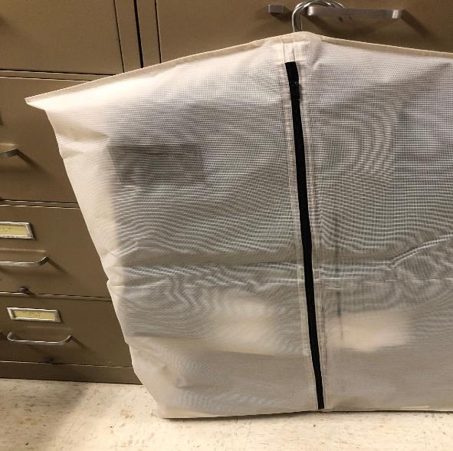
Fold pants NEATLY on the crease before putting on the hangar.
Put all DRY contents neatly in the garment bag.
Put a dryer sheet in the garment bag to keep things fresh
Storing Your Uniform

Slide 8
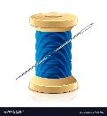
Maintaining Uniforms
Lining sticking out of Jacket:
Stitch or pin
Button is loose:
    Sew it on
Zipper is stuck:
Try running a candle (wax) on it
Get a different jacket/pants
Hat hurts head or strap breaks:
Time for a different hat
Suspenders are broken:
Get a different pair
It’s just too complicated/terrifying to deal with: Contact Connie or Deb.
No cutting of fabric
No sewing machines
Safety pins for quick fixes-REMOVE before cleaning!

Slide 9

This Presentation & More Help
Google: Dow High Music Boosters.
Music Groups => Band
Deb Mead: debmead@gmail.com
Connie Gavin: conniegavin13@yahoo.com

Slide 10
Questions?

Slide 11
Spirit Gear 2024

Slide 12
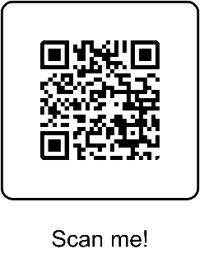
Spirit Wear
Spirit Wear: Great selection and the store is open now! Expected delivery week of Sept. 23
New this year…
*Marching Band - hoodies only
*Dow High Music Program - the design is for Band, Choir and Orchestra
This will be the ONLY sale this year, please
place orders by August 27!

Slide 13
Questions?

